Slide 1

Hot Wheels
Scott Bayreder
Gabrielle Byers
Idalmys Maza
Justin Wells

Slide 2
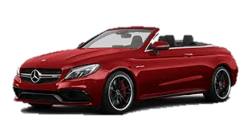
The Problem
Luxury cars are unattainable.
People want to buy them but
can’t afford them.
People want to impress their
friends for special events.
Disposable income wants to be spent.
People need a source of entertainment.

Slide 3
The Solution
Hot Wheels:
A luxury car rental service
Using the website, view inventory and choose a car to rent for the day

Slide 4
Minimum Viable Product
Target Audience: People looking to rent luxury cars for a day.
User Stories:
As a driver, I want to be able to rent luxury cars for entertainment.
As a driver, I want to be able to view available inventory so I can choose the car I want.
As a driver, I want to be able to create an account on the rental website so that I can rent a car.

Slide 5

The Approach
Routes:
HTML
Login
Register
Rental
Return
Models:
Cars
Customers
Transactions

Slide 6
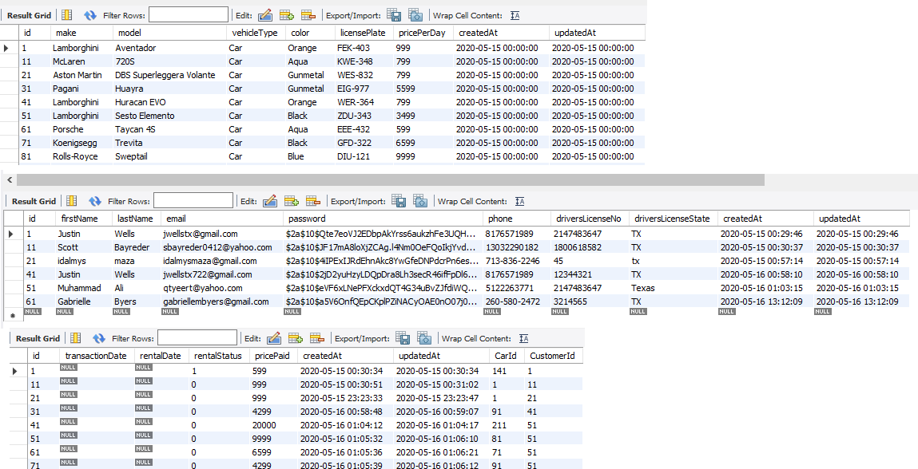
The Database

Slide 7


Challenges
Sequelize:
Foreign keys
git:
Version management

Slide 8
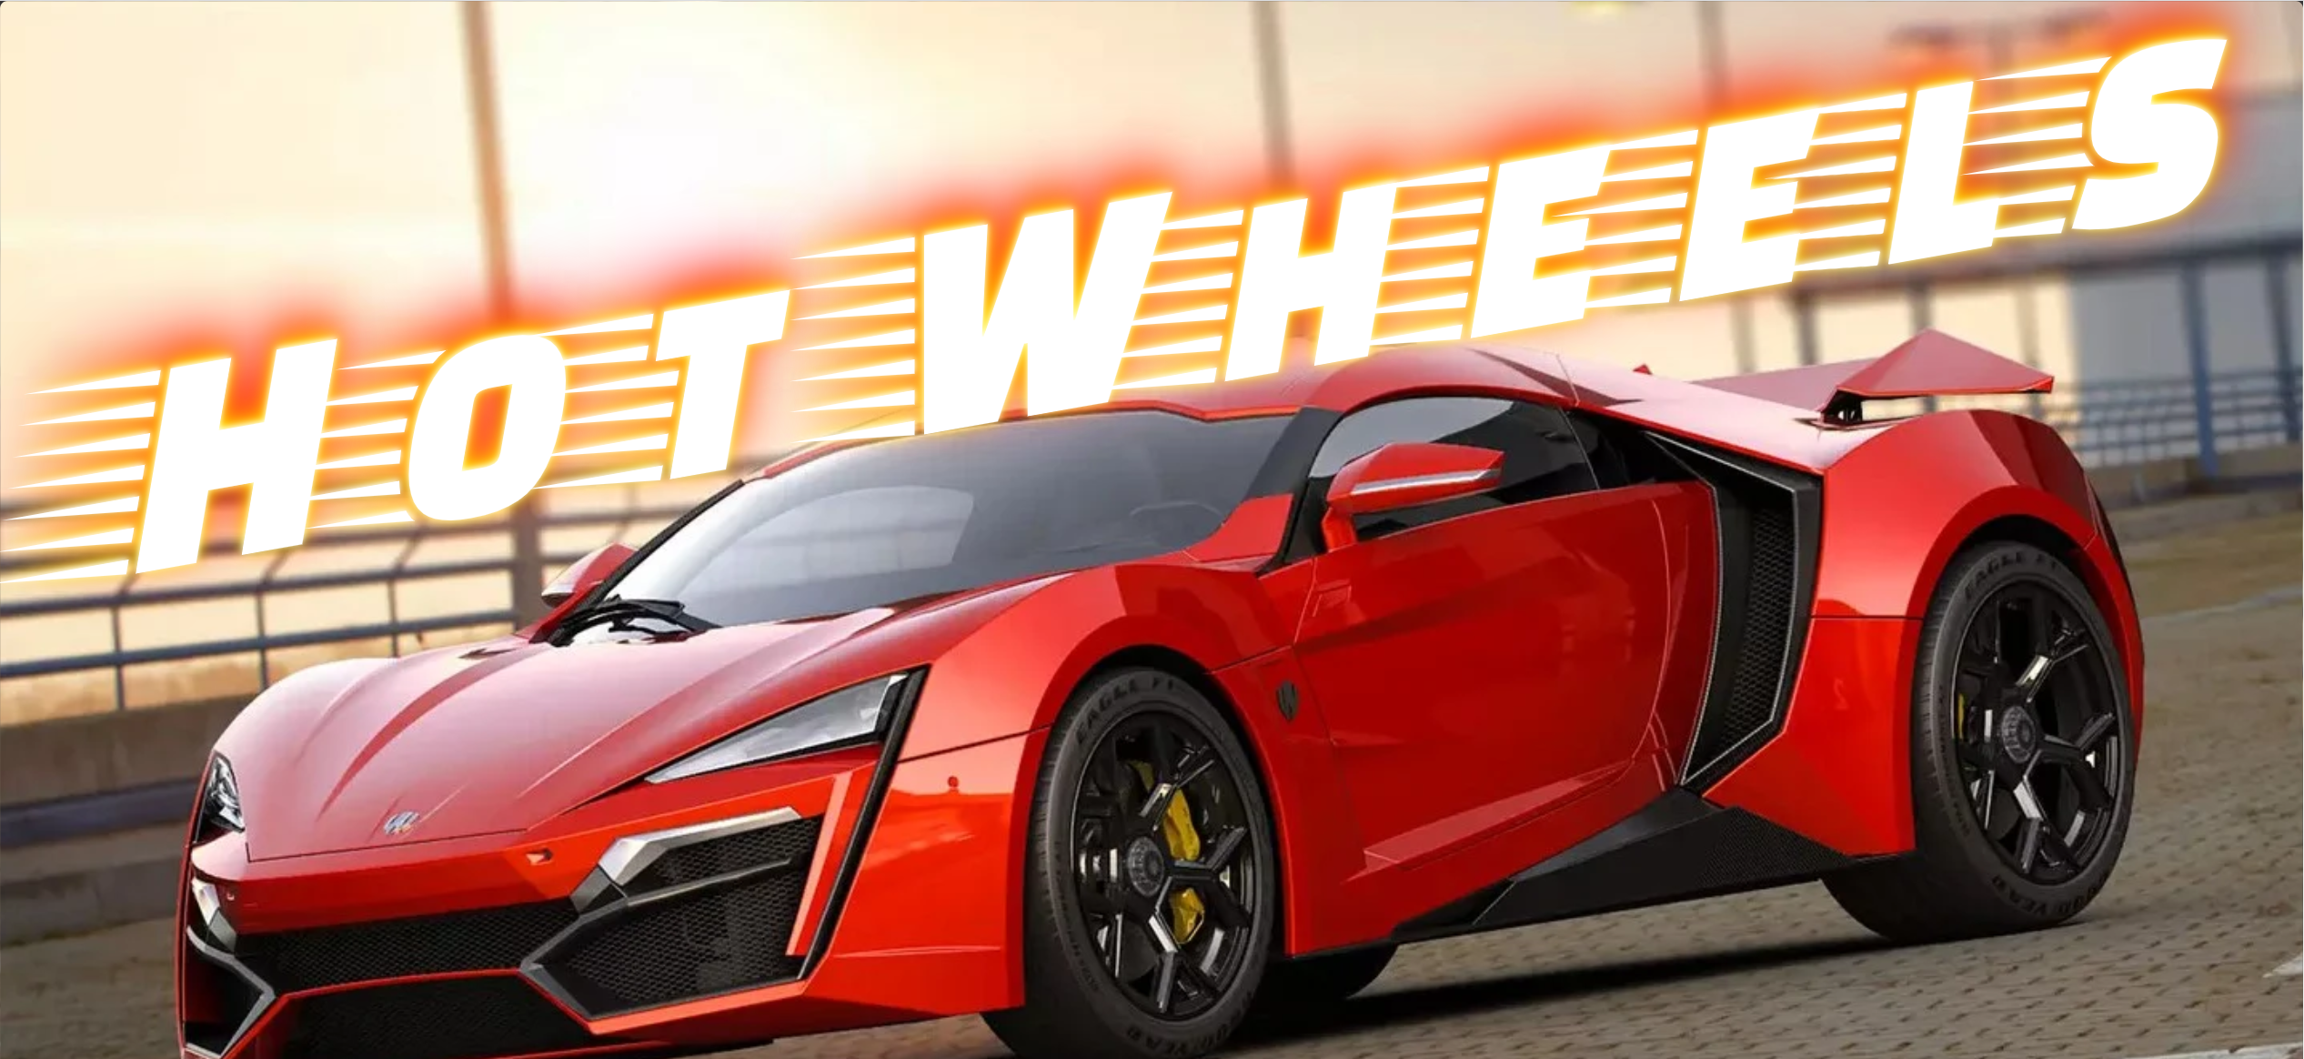
Demo

Slide 9



New Technologies
Pure CSS:
A set of small, responsive CSS modules
BCrypt Library:
A password hashing function
Mocha/Chai Testing:
JavaScript test framework

Slide 10

Future Enhancements
Reservation system:
Make reservations in advance and over multiple days
Admin page:
Manage inventory, rental status
Payment page:
Accept online payment

